Slide 1
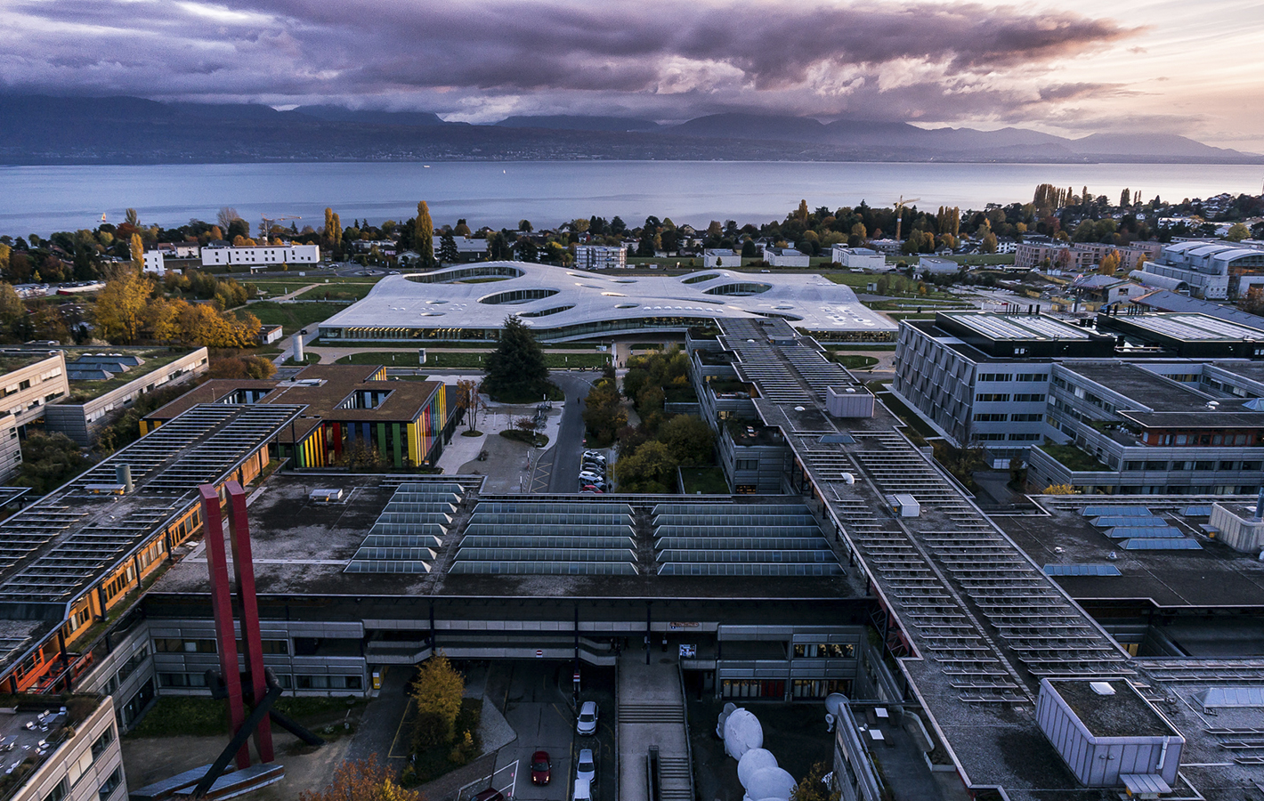
Exploring sustainability in carbon capture: optimizing material synthesis and process efficiency
Sanjay Venkatachalam
Sustainability in my research
03 December 2024

Slide 2

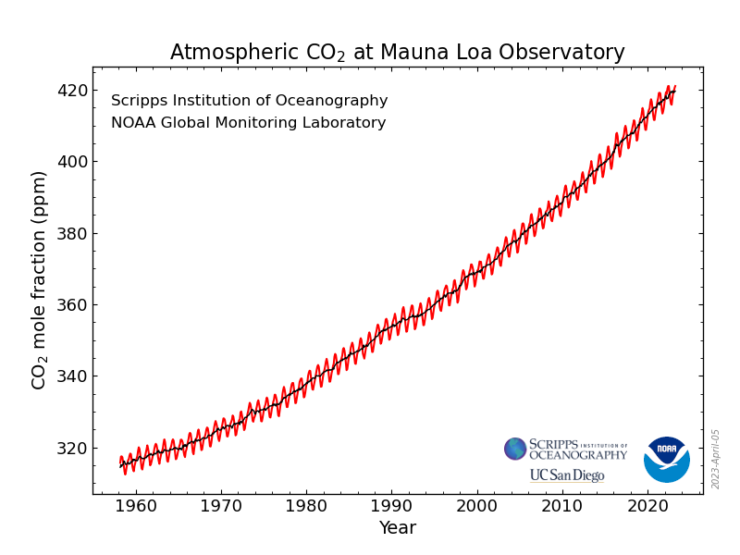
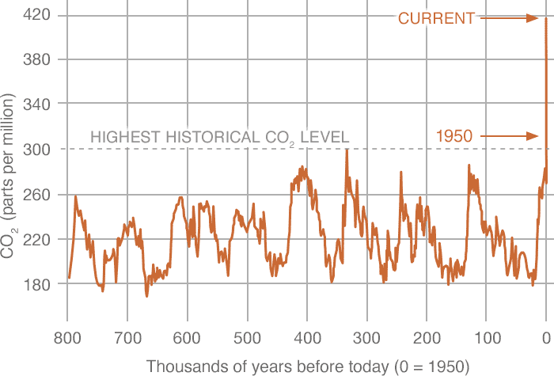
Historical CO₂ emissions
01st Dec’24 : 425.10 ppm
ENG 650 : Sustainability in my research
climate.nasa.org
National Oceanic and Atmospheric Administration, noaa.org
IPCC, 2022: Climate Change 2022: Impacts, Adaptation, and Vulnerability. Cambridge University Press.

Slide 3
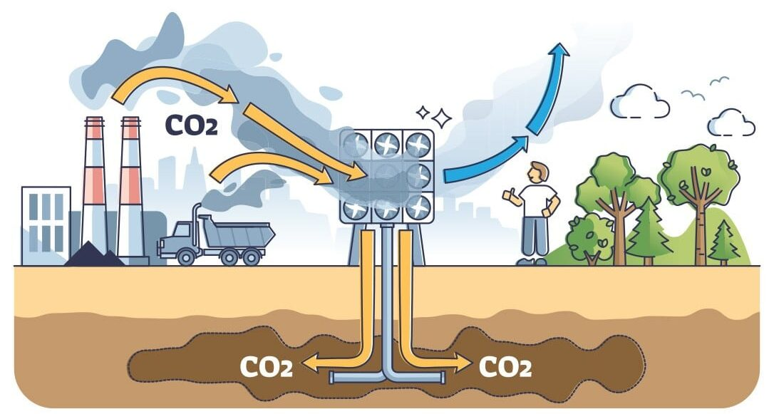
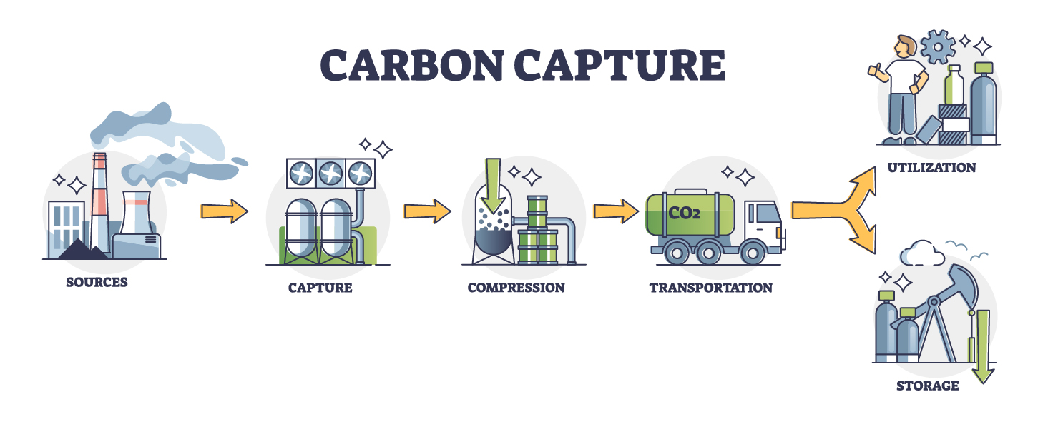
CO₂ emissions from industries
37.4 GtCO₂ – emissions as of 2024
24% of the total emissions: comes from industries
ENG 650 : Sustainability in my research
Capturing CO₂ from the exhaust of these industries
IPCC, 2022: Climate Change 2022: Impacts, Adaptation, and Vulnerability. Cambridge University Press. doi:10.1017/9781009325844.
Our world in data – emissions by sector, https://ourworldindata.org/ghg-emissions-by-sector
Notes:
Reduce Fossil Fuel Dependency, Preserve and Restore Ecosystems, Adopt Sustainable Agriculture, Enhance Energy Efficiency

Slide 4
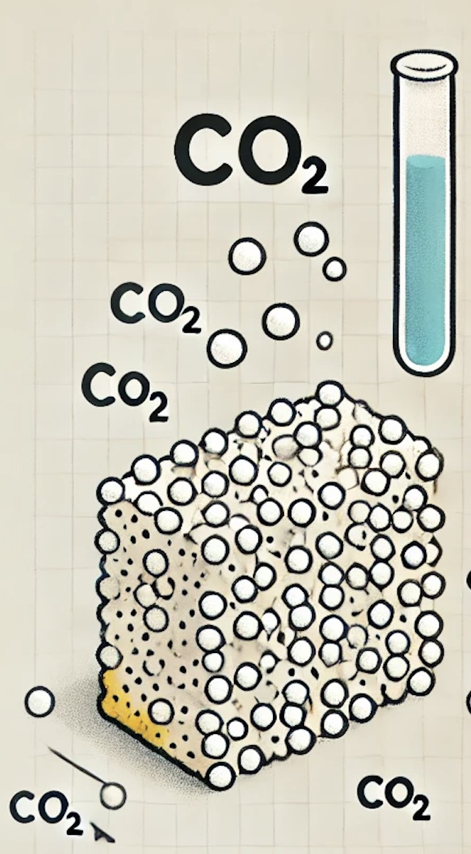
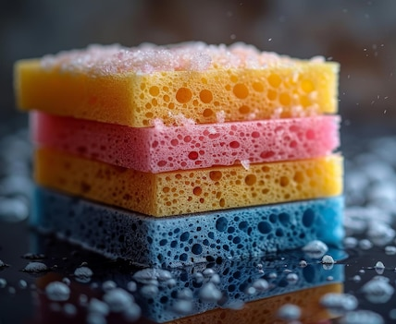



My PhD research and overview of CO₂ capture process
Synthesizing adsorbent materials for capturing CO₂ from the industrial flue gas mixtures (majorly consisting of CO₂, N₂, O₂, H₂O)
Desorption/regeneration
to CO₂ sequestration facility
ENG 650 : Sustainability in my research
Design: Favors capture of CO₂ over other gases – CO₂ selective!
Adsorption

Slide 5
Sustainable challenges with adsorption based CO₂ capture
High energy demand during adsorbent production (e.g., high-temperature processes).
Significant energy required for adsorbent regeneration.
Both of them potentially contributing to emissions.
ENG 650 : Sustainability in my research

Slide 6
Energy consumed for adsorbent regeneration
Heating alone :
temperature swing adsorption
(TSA)
Both heating and vacuum:
Temperature vacuum swing adsorption
(TVSA)
Using steam:
Steam assisted- temperature swing adsorption
(SA-TSA)
N. Jiang et al, Journal of CO2 Utilization, vol. 35, pp. 153–168, 2020.

Slide 7


Emissions from adsorbent synthesis and its regeneration
Life cycle assessment was commisioned to compare different regeneration technologies (for capturing 1 kg CO₂)
2017 electricity mix of Switzerland was used (mix of hydro, natural gas, nuclear, wood chips, biogas)
Cradle-to-grave approach
emissions associated with the process
infrastructure (includes the manufacturing of of adsorption columns and zeolite material production), and
end-of-life
0.85 kg CO₂/ kg adsorbent

Slide 8





Methods to reduce emissions
Adsorbent
Energy efficient methods
Sustainable raw materials
Process
Waste heat recovery from industries
Innovative heating methods (ex. Microwave assisted regeneration)
Transition to renewables

Slide 9
Methods to reduce emissions
Adsorbent
Energy efficient methods
Sustainable raw materials
Process
Waste heat recovery from industries
Innovative methodologies (ex. Microwave assisted regeneration)
Transition to renewables

Slide 10
Shifting to renewable energy sources with the projected 2030 electricity mix
2017 electricity mix of Switzerland (mix of hydro, natural gas, nuclear, wood chips, biogas, imported)
Projected 2030 electricity mix (mix of hydro, wind, biogas, imported)

Slide 11
What would be the future goals?
Exploring other levers in reducing emissions
Understanding the emissions as each optimization is carried out in terms of both material synthesis and process

Slide 12
Thank you for your kind attention

Slide 13
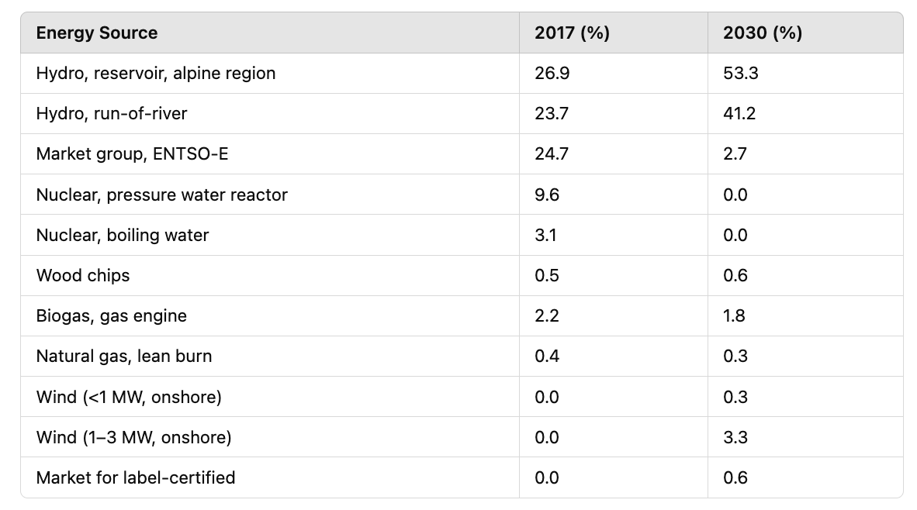
Backup slide
Europen interconnected grid
European Network of Transmission System Operators for Electricity (ENTSO-E).

Slide 14
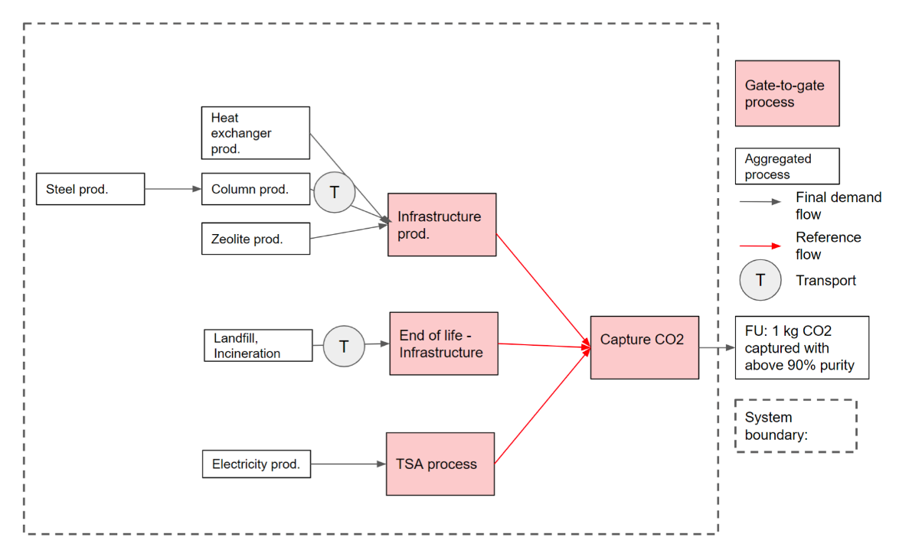
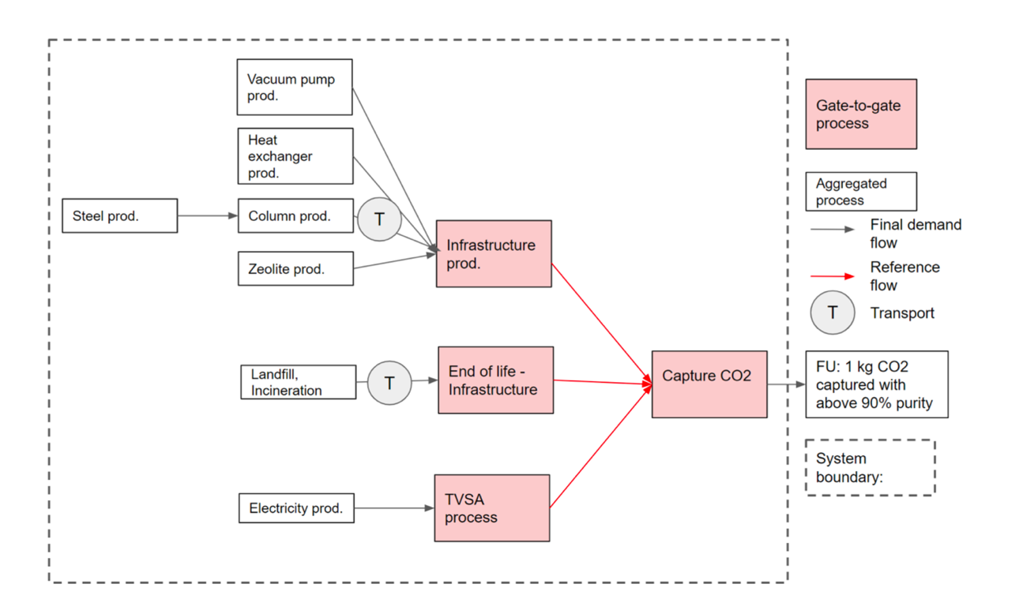
TSA
TVSA

Slide 15
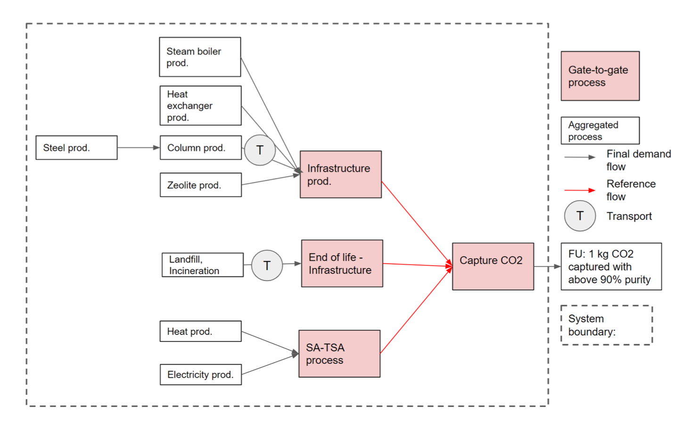
SA- TSA

